Slide 1

DIAGNOSIS OF DIABETES MELLITUS USING ARTIFICIAL NEURAL NETWORKS
Pimpri Chinchwad Education Trust’s
Pimpri Chinchwad College of Engineering
Dept. Of ELECTRONICS & TELECOMMUNICATION ENGINEERING
Guide name: Ms. Isha Vyas
Students Name:
1.Ruchita Pame(TYETC198)
2.Akash Patil(TYETC199)
3.Shruti Pingale(TYETC203)

Slide 2

Introduction
Diabetes Prediction Systems belong to a larger category of prediction systems that generate predictions based on user inputs. Our diabetes prediction system use deep learning algorithms to determine whether or not a person is diabetic.
Early diagnosed of diabetes plays a very important role in the treatment of the disease. According to IDF,about 232million people(50% of total population) remain undiagnosed of the disease.

Slide 3
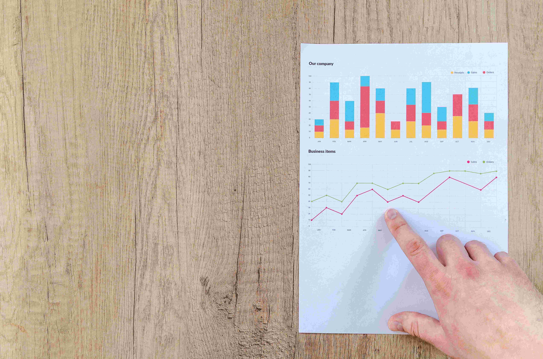
What Is Diabetes Prediction System?
Objectives Of The Projects are:
Retrieving data for building dataset and splitting the dataset into training set and test set.
Experimenting on different machine learning models available for our processed data.
Integrate the model with the web application for preforming the prediction

Slide 4
We further going to implement Following Algorithms:
Support Vector Machine
Decision Tree
KNN
Random Forest

Slide 5
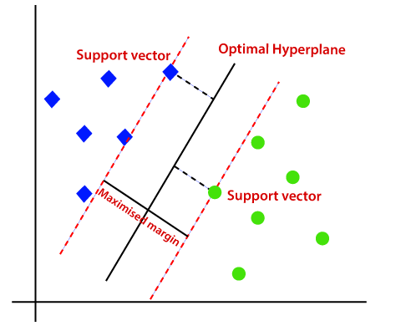
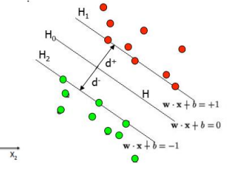
Support Vector Machine
Support Vector Machines (SVM) are a set of machine learning approaches used for classification and regression.
A support vector machine takes these data points and outputs the hyper plane (which in two dimensions it’s simply a line) that best separates the tags.

Slide 6
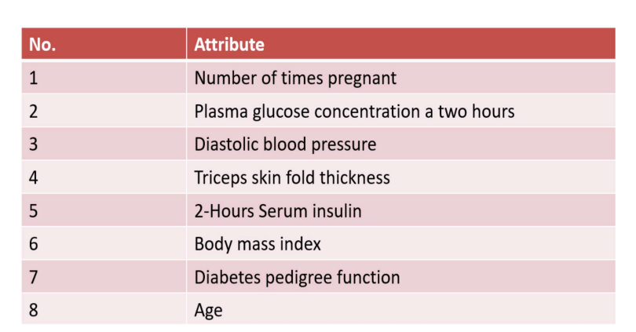
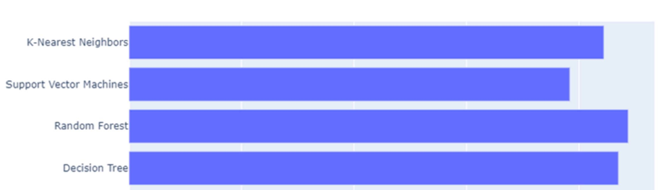
Observation Results
Fig.- Dataset Attributes
Fig.- Algorithms Accuracy
From the above bar chart, it is clear that Random Forest Classifier followed by Decision Tree gives the best predictions for the processed data. Considering this chart, we can use Random Forest Classifier for our project. Random Forest is ensemble classifier made using many decision trees where ensemble means that uses multiple machine learning algorithm to obtain the predictive performance.

Slide 7
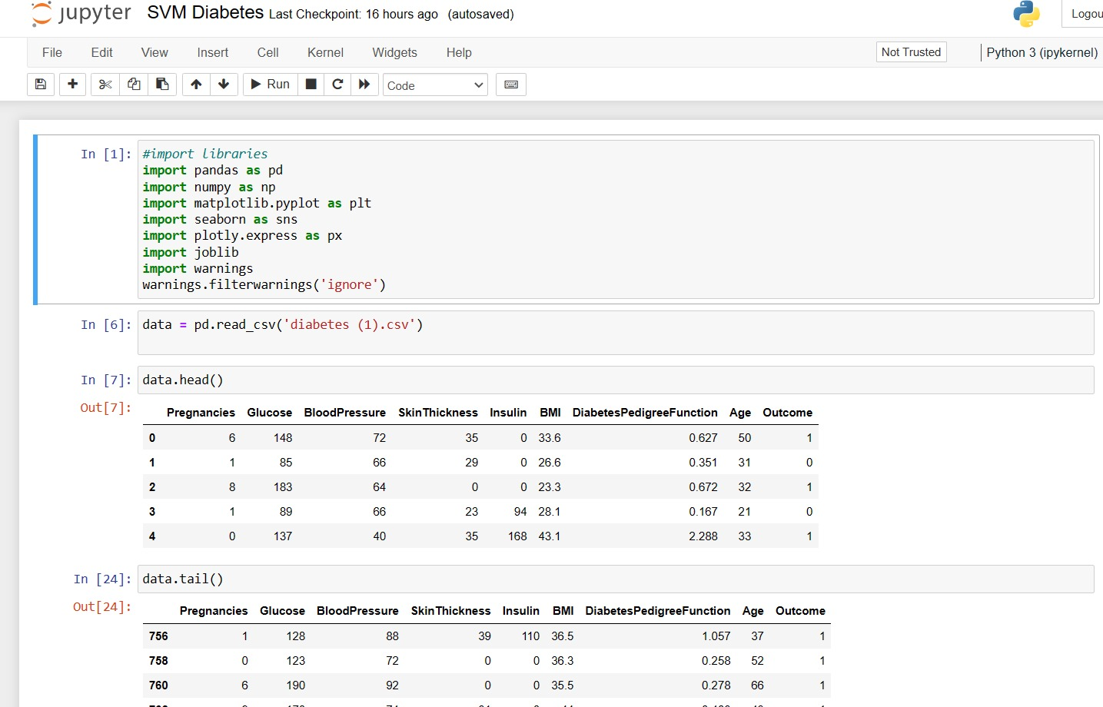
SVM Results:

Slide 8
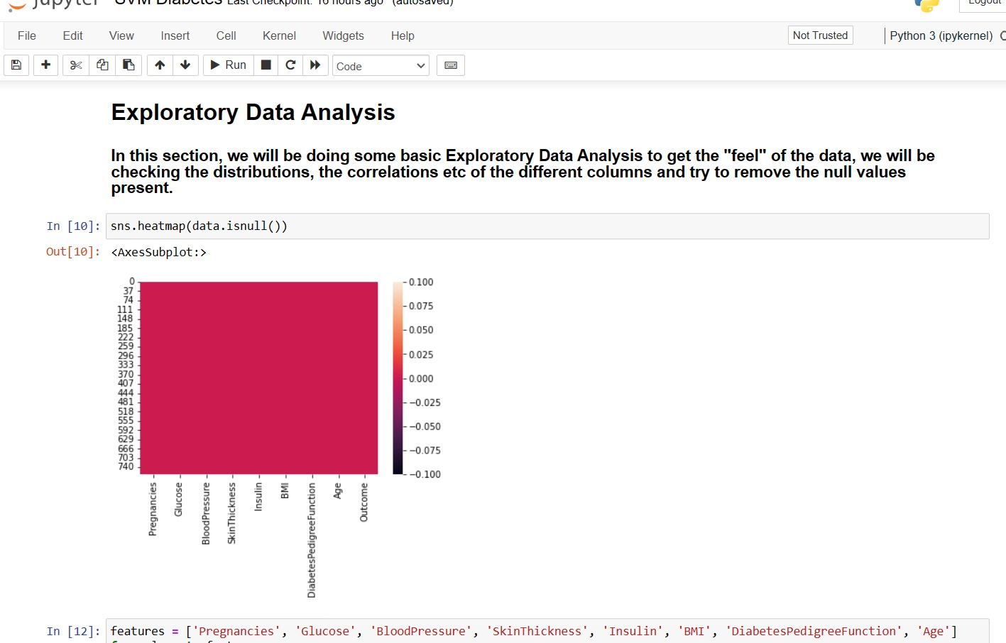
SVM Results:

Slide 9
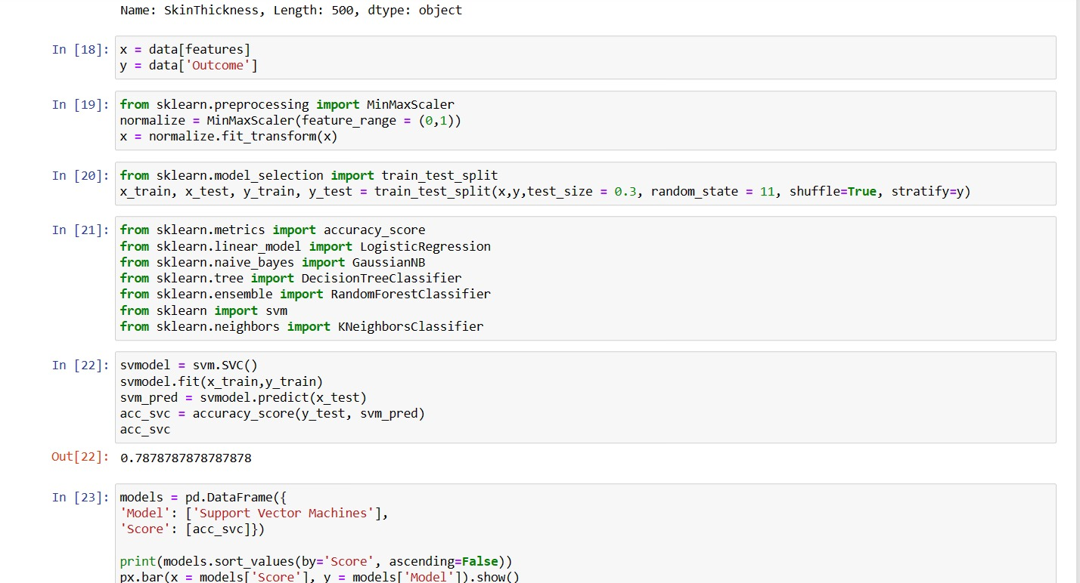
SVM Results:

Slide 10
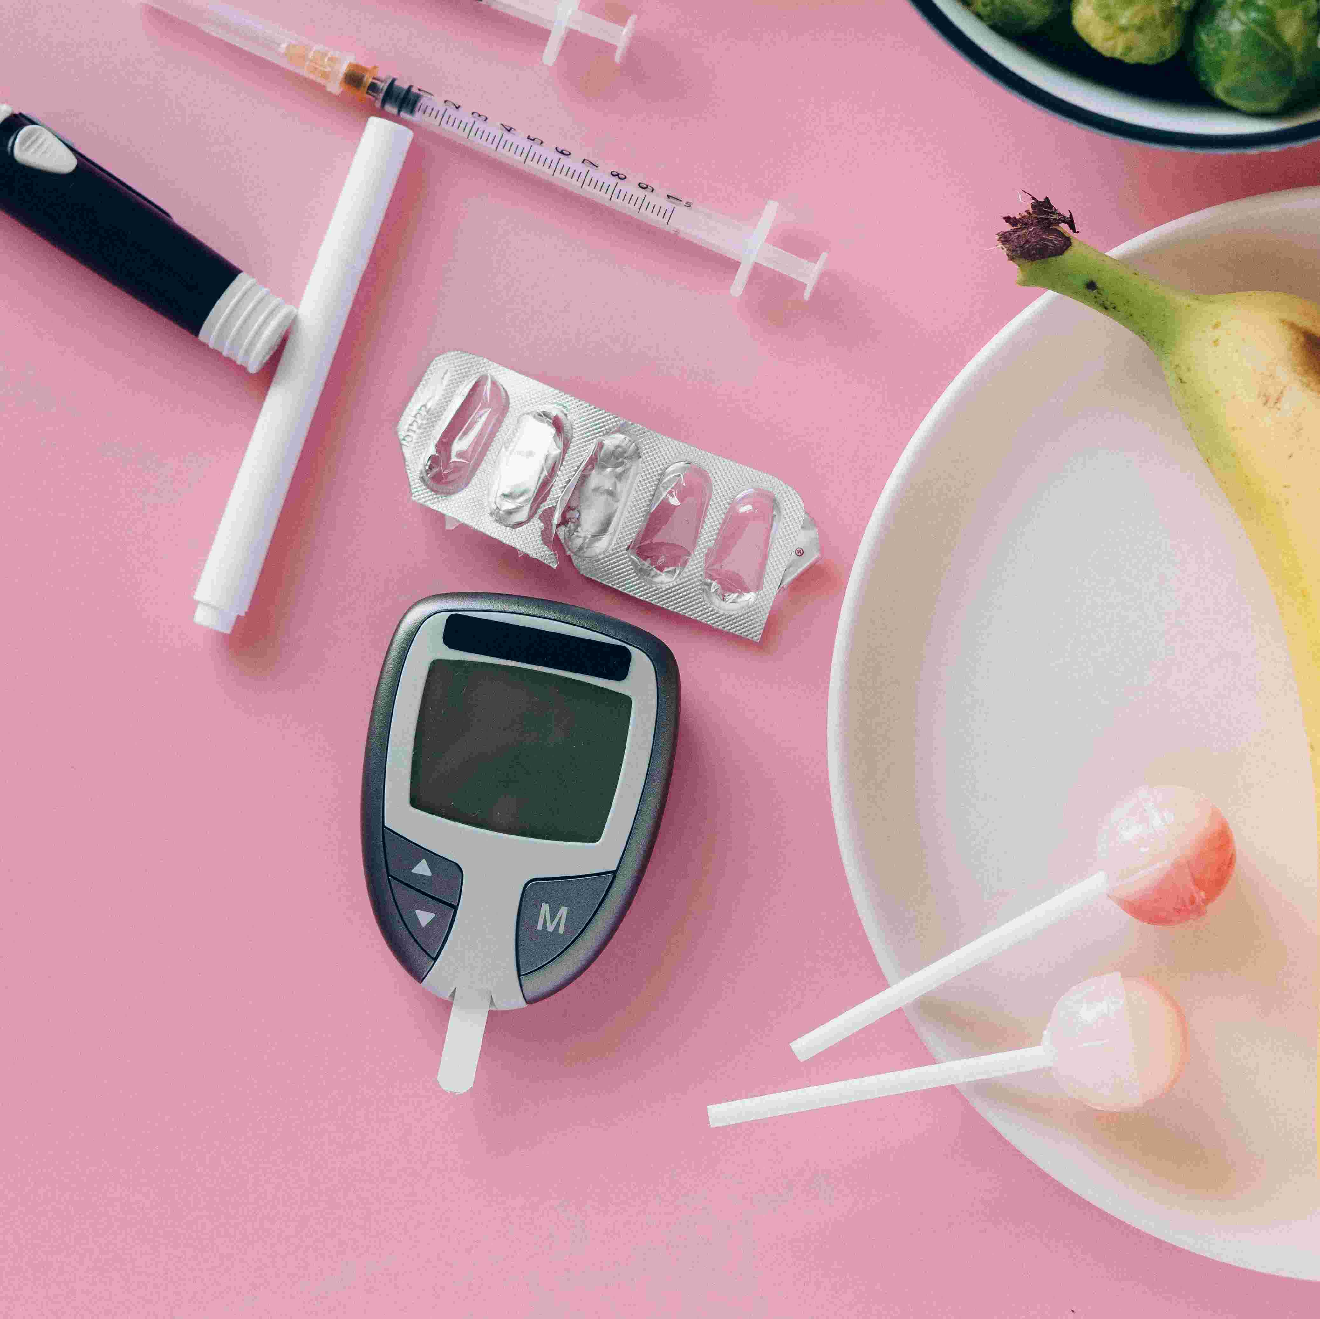
Conclusion
Detection of diabetes in its early stages is the key for treatment.
Machine learning has the great ability to revolutionize the diabetes risk prediction with the help of advanced computational methods and availability of large amount of epidemiological and genetic diabetes risk dataset.
The focus of this project has been on implementing a software system that will take into consideration the various factors that affect diabetics.

Slide 11
References
1. L. Beqiri; A. Velinov; B. Fetaji; L. Loku; A. Buçuku; Z. Zdravev,”Analysis of Diabetes Dataset”, 2020 43rd International Convention on Information, Communication and Electronic Technology (MIPRO),IEEE.
2. B. Nithya and Dr. V. Ilango,” Predictive Analytics in Health Care Using Machine Learning Tools and Techniques”, International Conference on Intelligent Computing and Control Systems, 978-1-5386-2745-7, 2021
3. B. SRIDHARA MURTHY; J. SRILATHA, Comparative Analysis on Diabetes Dataset Using Machine Learning Algorithm, 02 August 2021,IEEE
4. Priyanka Indoria, Yogesh Kumar Rathore, “A Survey: Detection and Prediction of Diabetes Using Machine Learning Techniques” ,Vol. 7 Issue 03, March-2020, International Journal of Engineering Research & Technology (IJERT).

Slide 12
Thank You!

